Slide 1
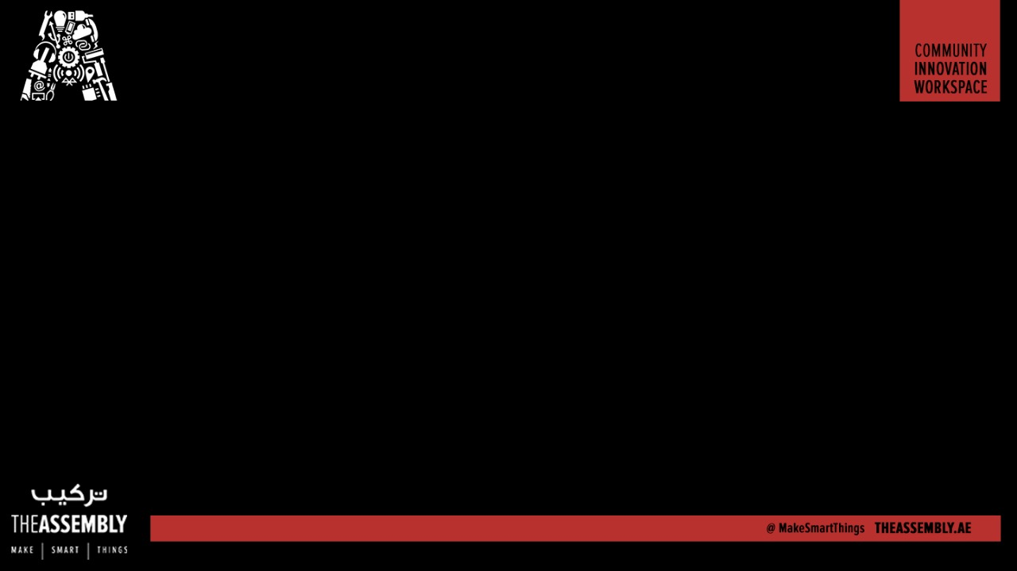
Make any surface a Touch button
Presented By : The Assembly Team

Slide 2
Why make it?
Using a touch surface that is “invisible” to the eye, but works to activate/deactivate your smart device when you touch a portion of the surface where it is installed.
Applications :
create a touch surface with aluminum foil
Using the foil as a controller to play a game (ping pong)

Slide 3
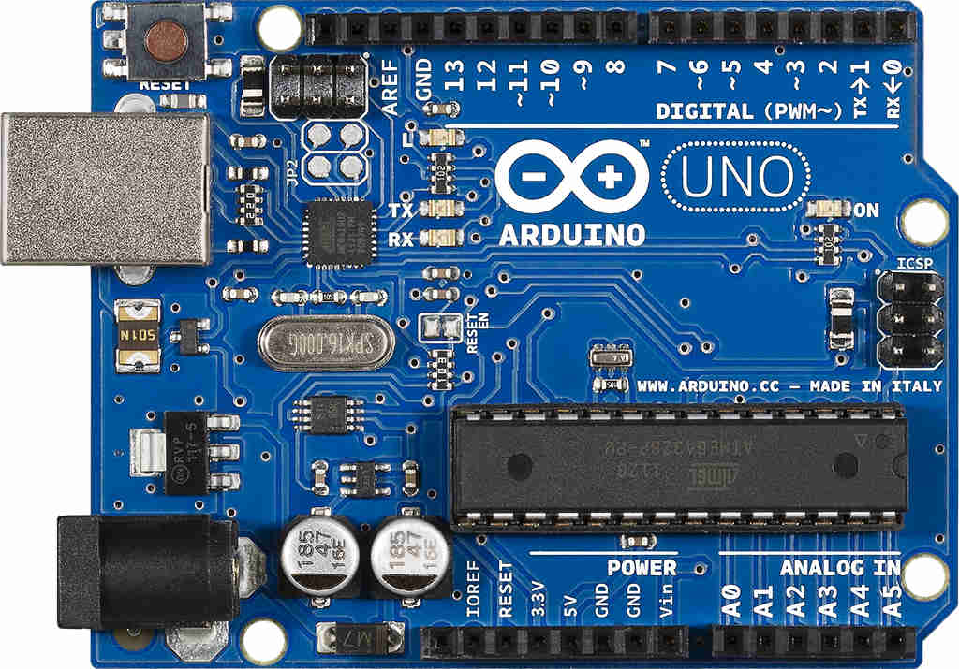
Arduino UNO
Notes:
The Arduino Nano is a small, complete, and breadboard-friendly board based microcontroller
Nano has two extra analog pins
Good replacement for uno as it is breadboard friendly

Slide 4
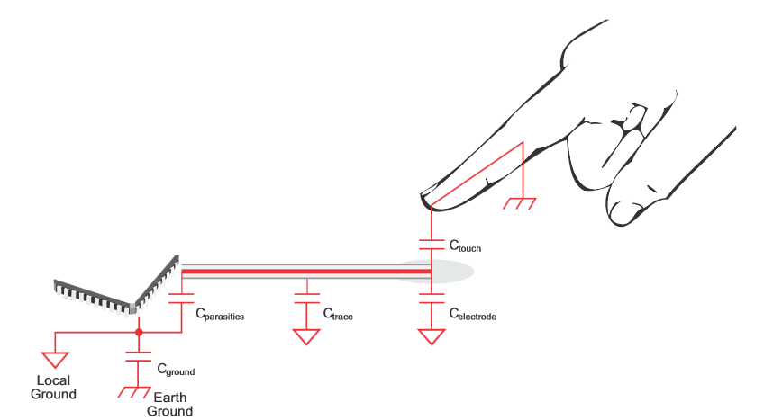
Capacitive touch surface
Notes:
*The MPU-6050 is not expensive, especially given the fact that it combines both an accelerometer and a gyro.
Therefor it captures the x, y, and z cordinates at the same time.
The MPU-6050 always acts as a slave to the Arduino with the SDA and SCL pins connected to the i2C
Ad0 meant to access complex functionalities for the i2c programming but in our case we are grounding it.
The interupt pin of mpu6050 helps the microcontroller know that fresh data has been arrived in the register which can be read by the controller.

Slide 5
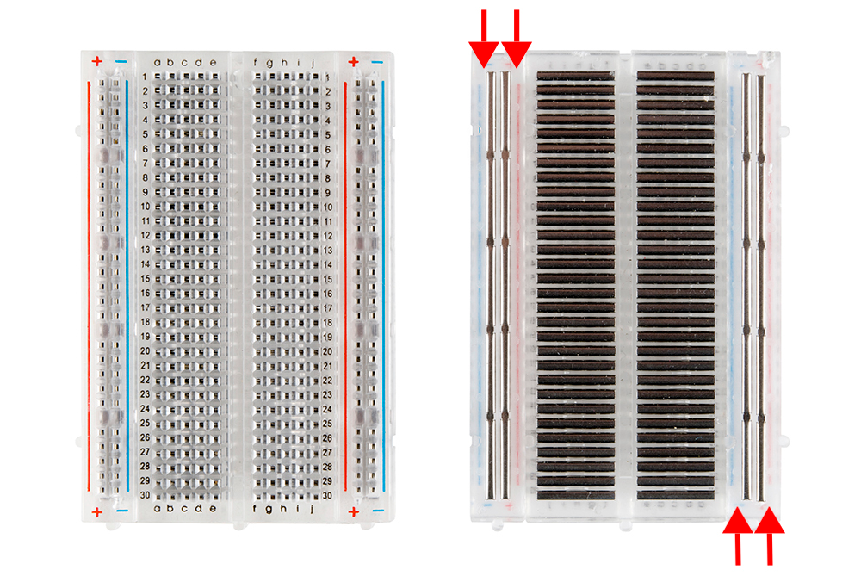
BreadBoard

Slide 6
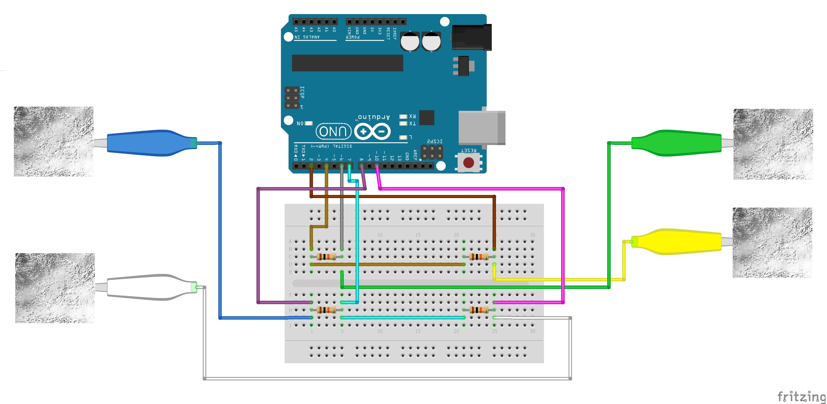

Slide 7
Testing the system
Download the Arduino IDE and Processing IDE
Download the Arduino code and circuit schematic as well as Processing code from: https://github.com/The-Assembly/arduino_pong
Upload the Arduino code
In the processing code, change the COM value in line 4 according to what COM value you set in your Arduino upload.

Slide 8

THANK YOU

